Slide 1

ITC4214A1 - INTERNET PROGRAMMING – FINAL PROJECT
ShipLink: Smart Logistics & Job Matching Platform
Batsaris Nikolas

Slide 2
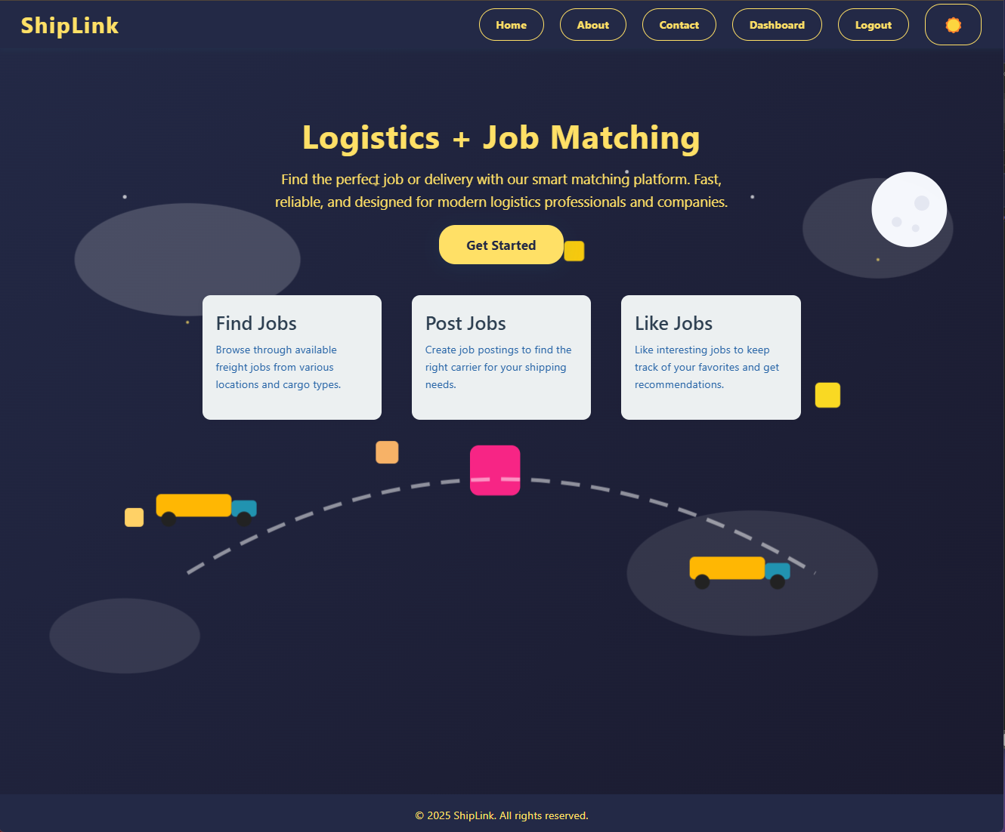
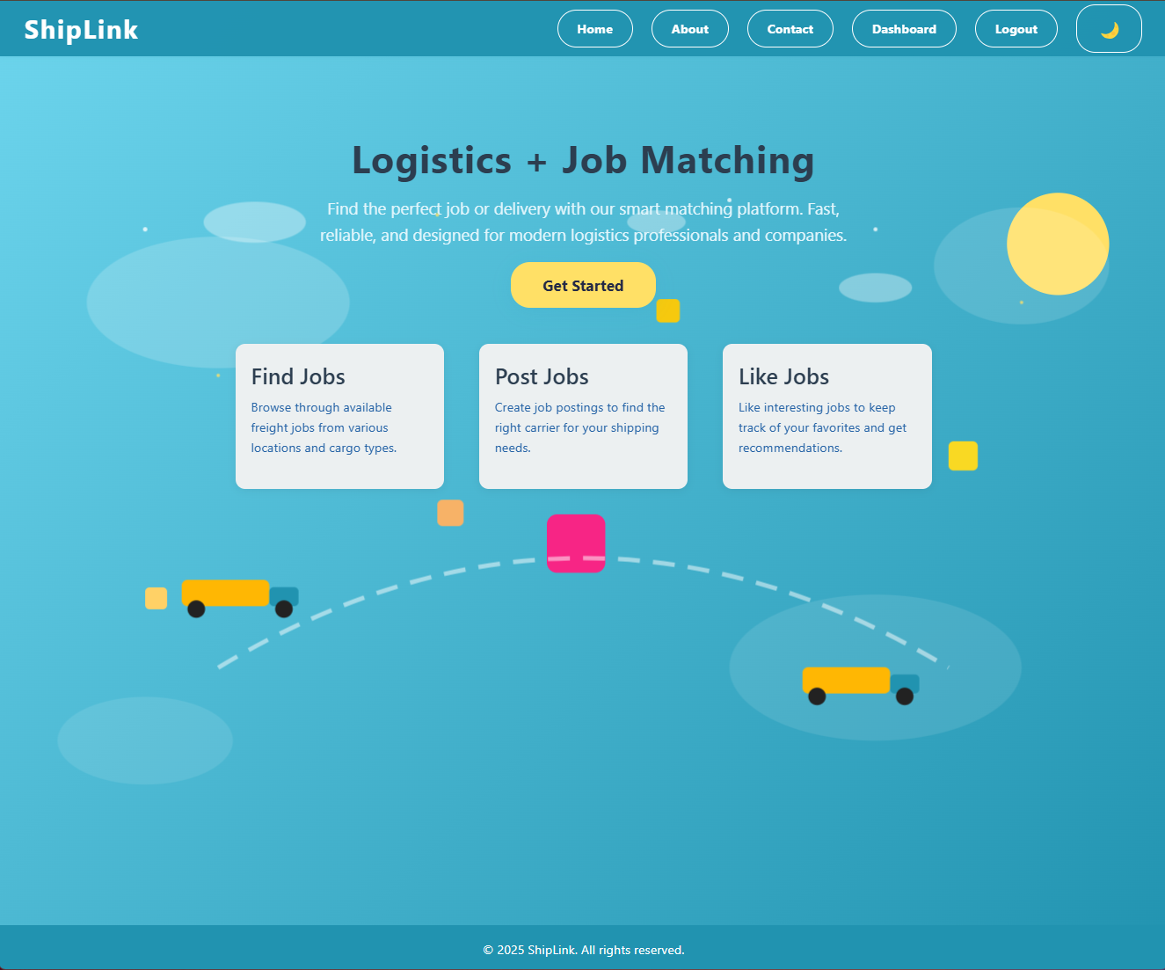
Home Page – Light & Dark Mode

Slide 3
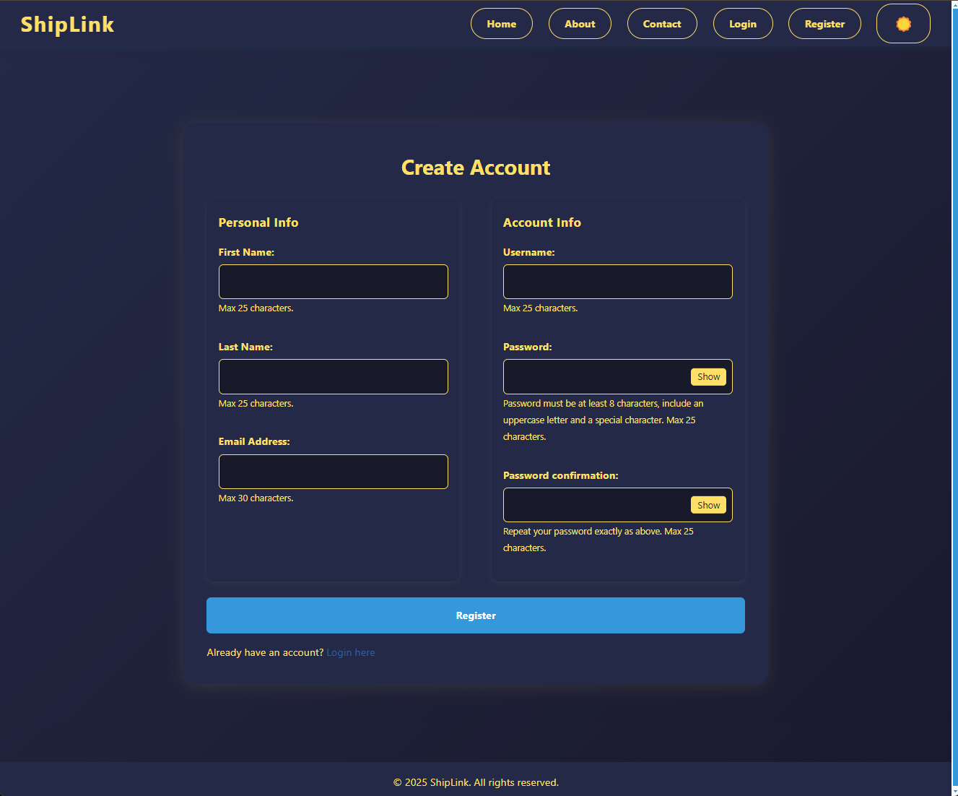
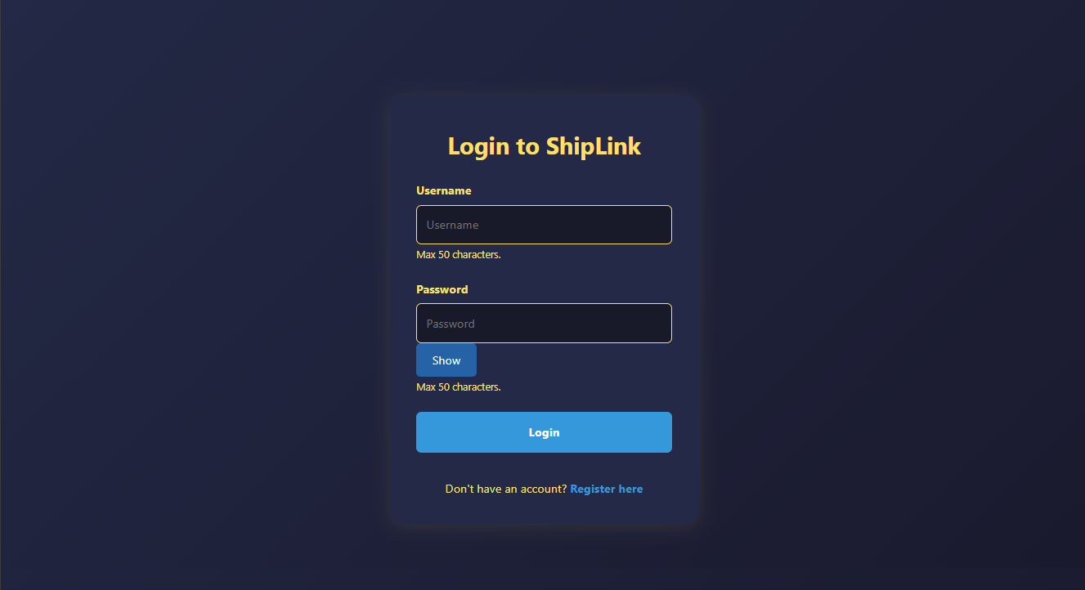
REGISTER & LOGIN

Slide 4
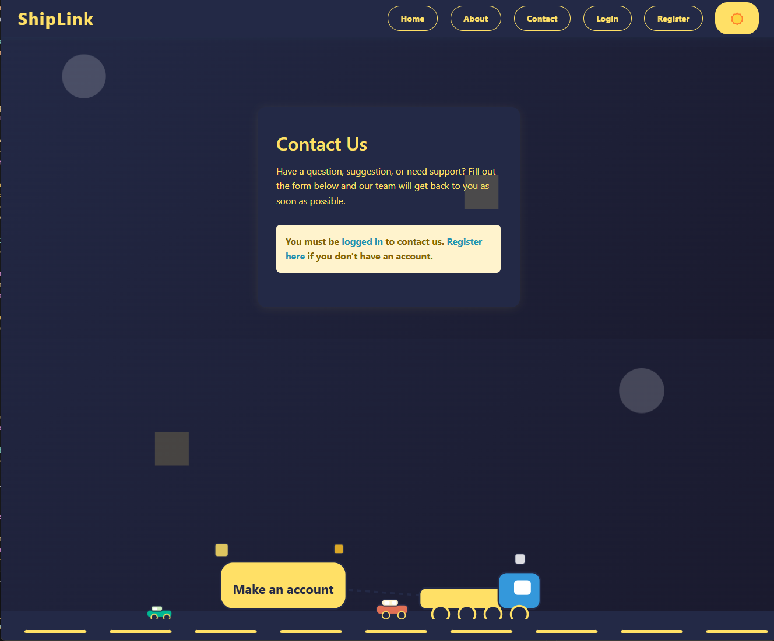
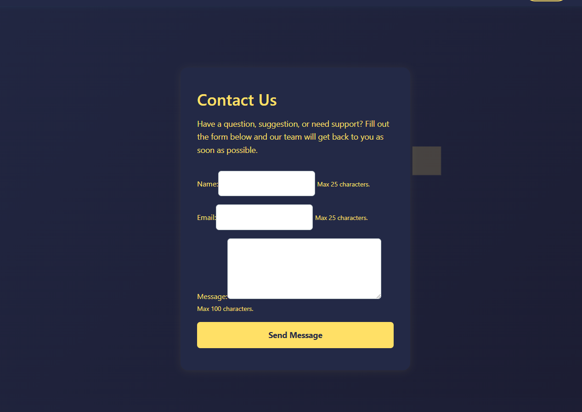
CONTACT US PAGES

Slide 5
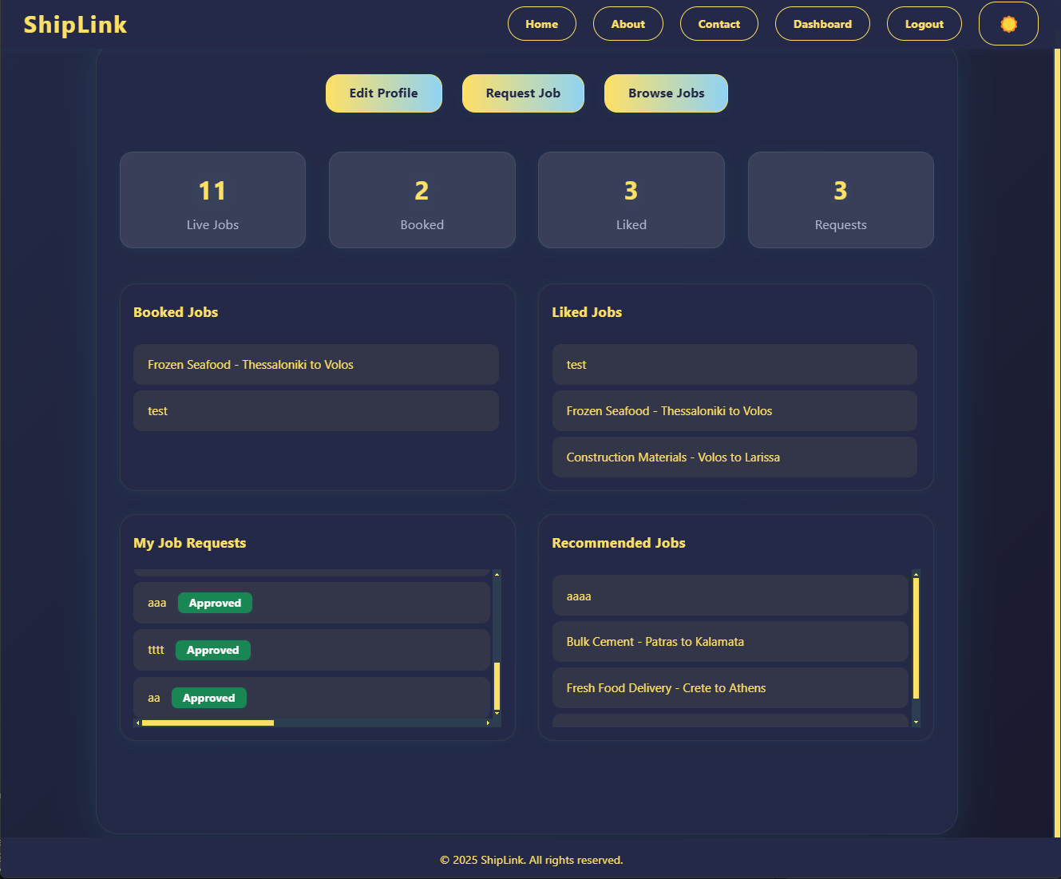
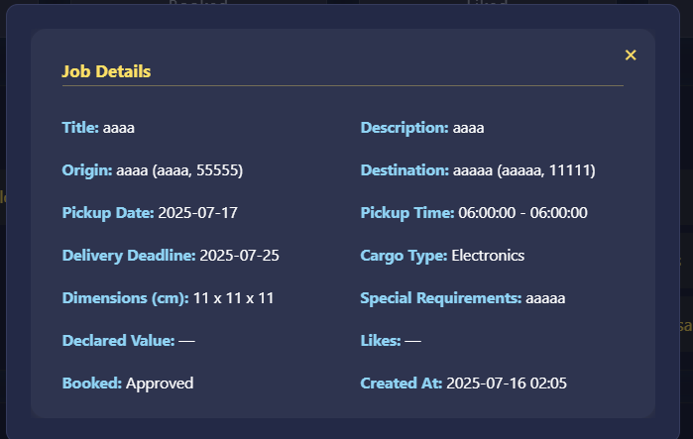
User Dashboard
User personal Information on jobs like his bookings, liked jobs, requests and recommendations
General Job information
Edit, Request, and Browse job Buttons

Slide 6
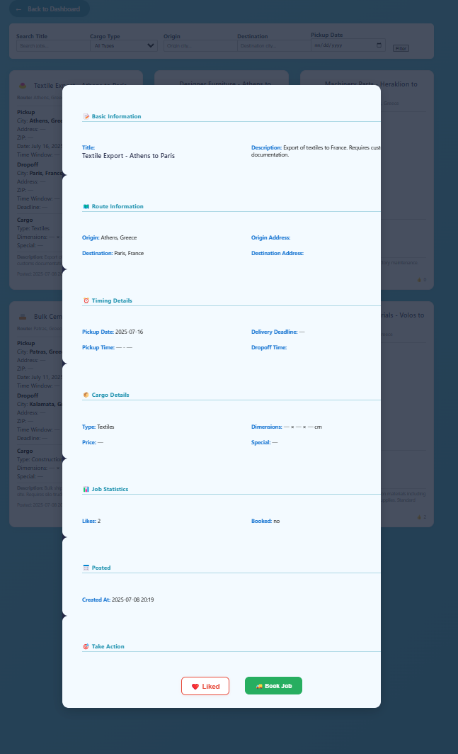
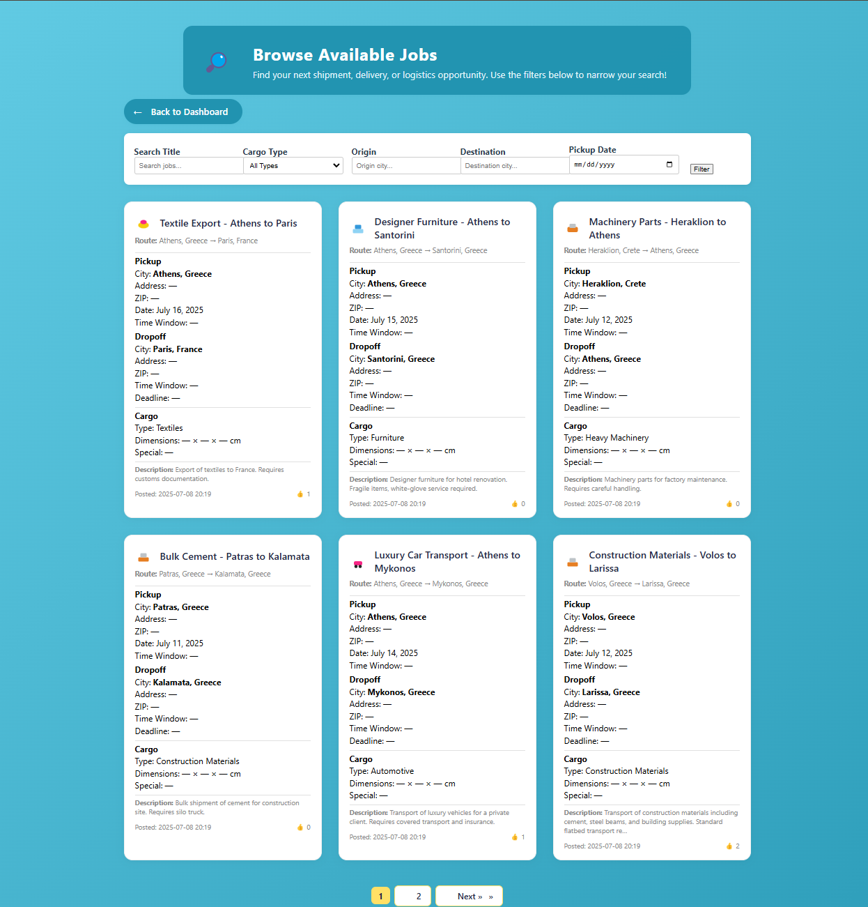
Available Job List & Details

Slide 7
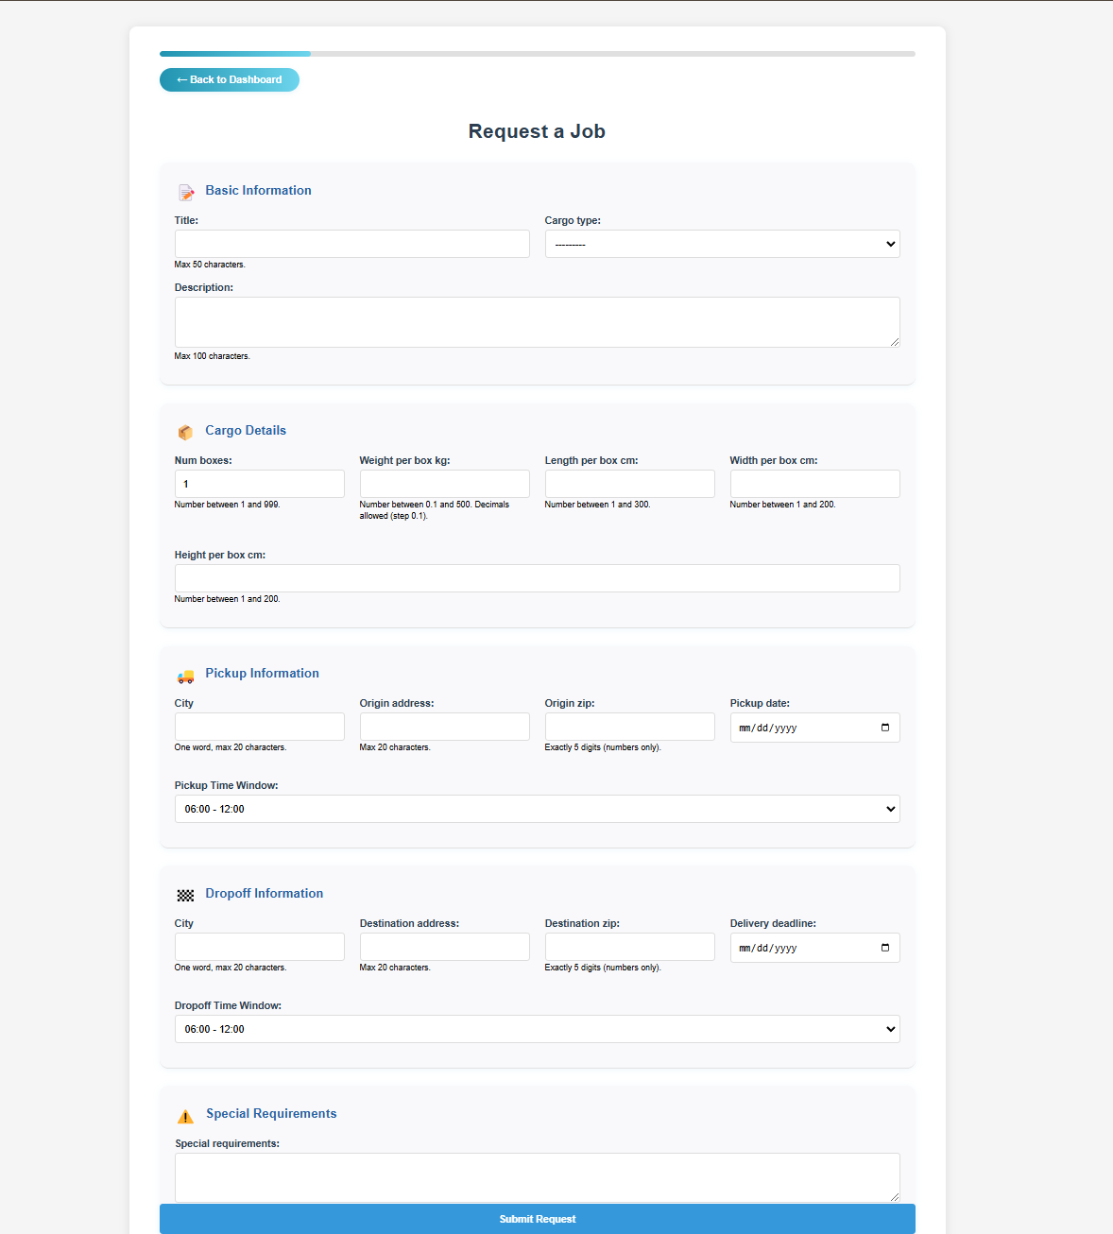
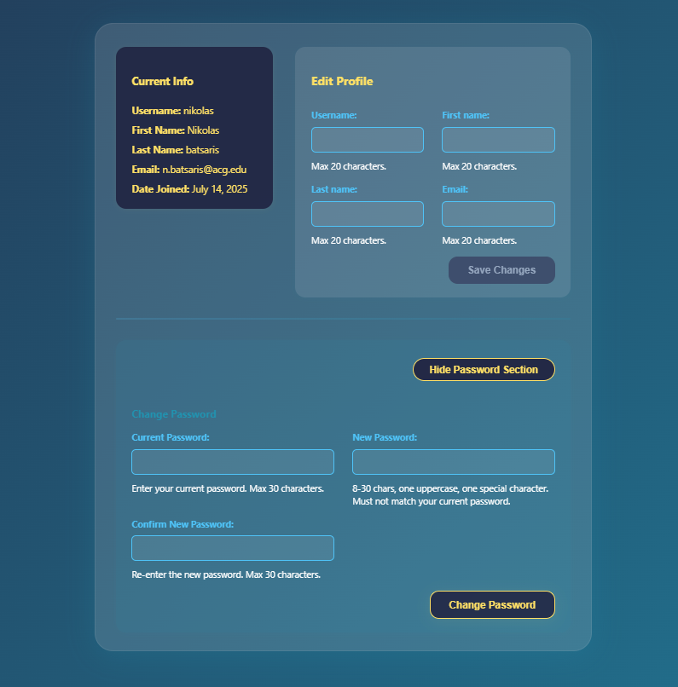
Request Job & Edit Profile

Slide 8
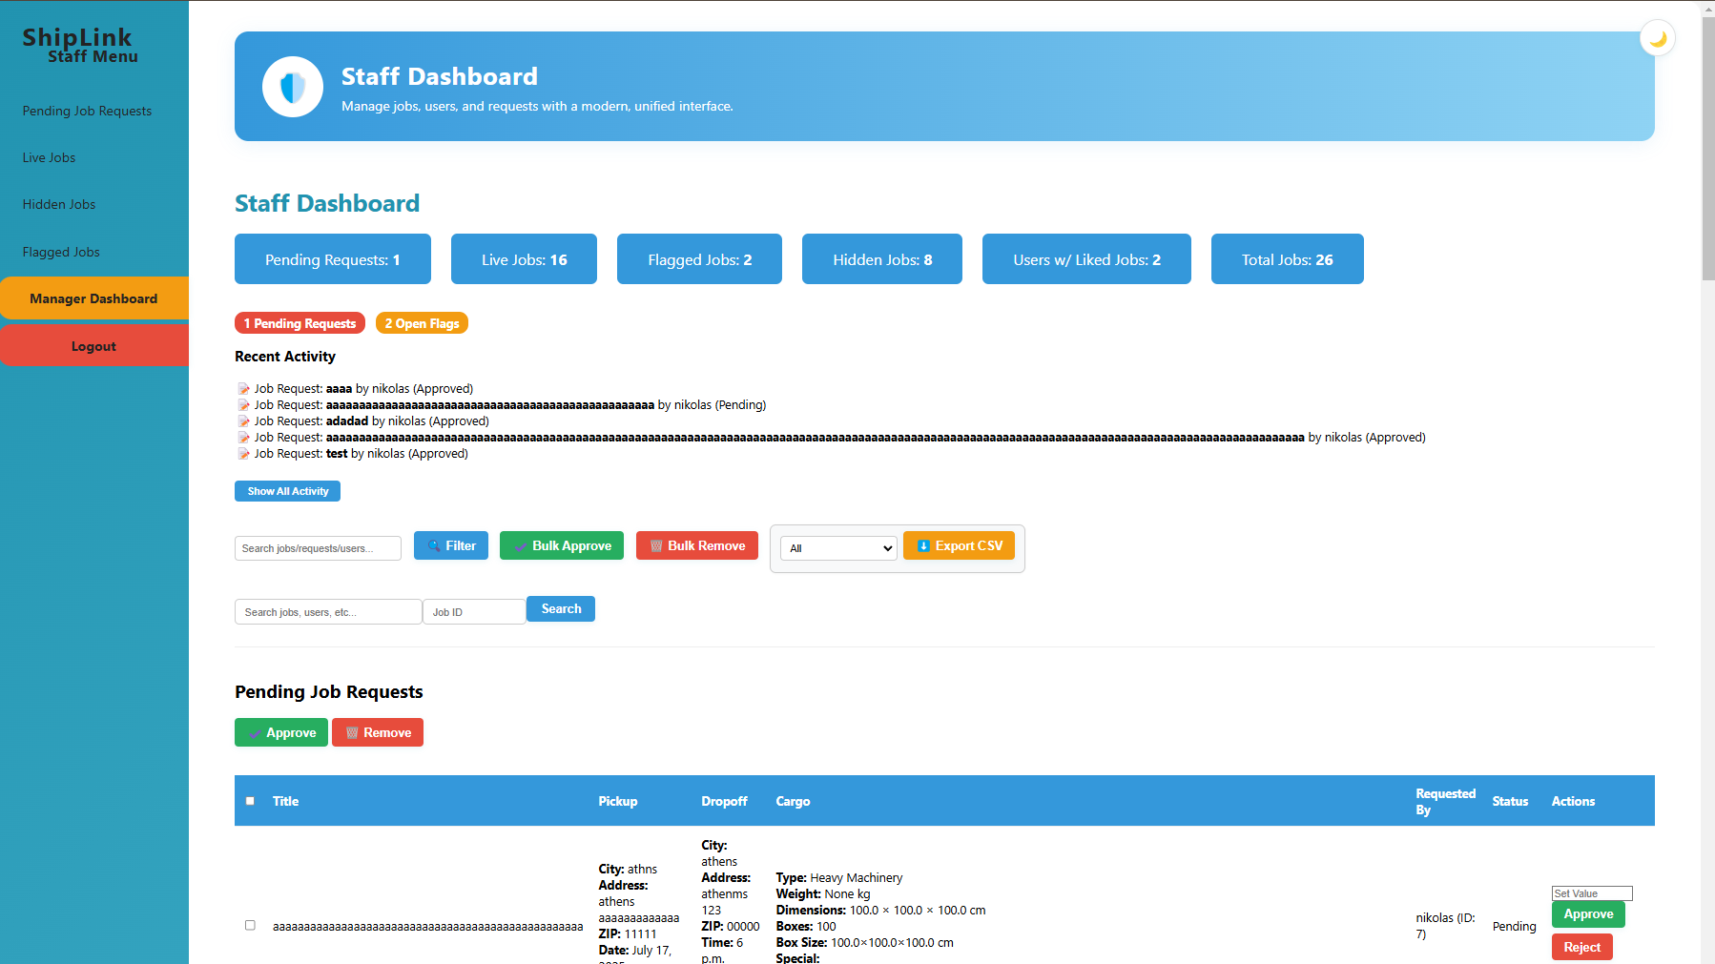

Slide 9
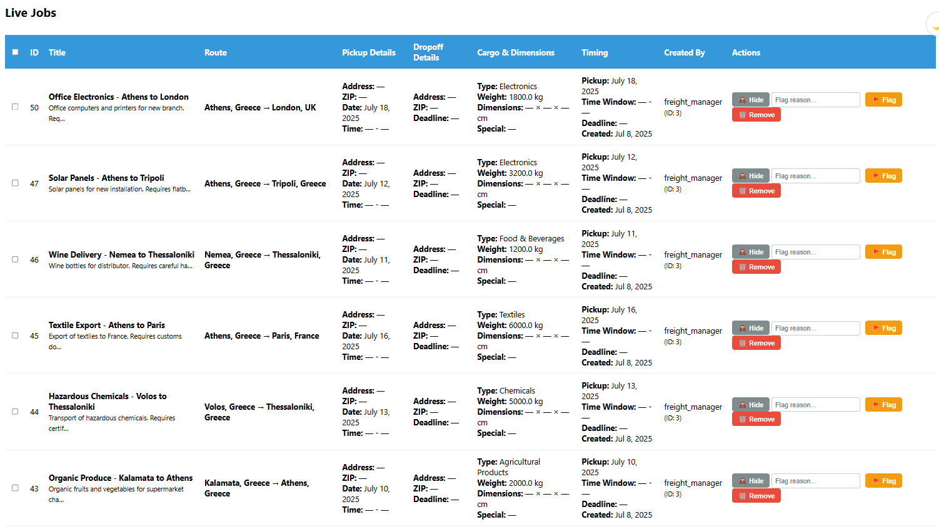

Slide 10
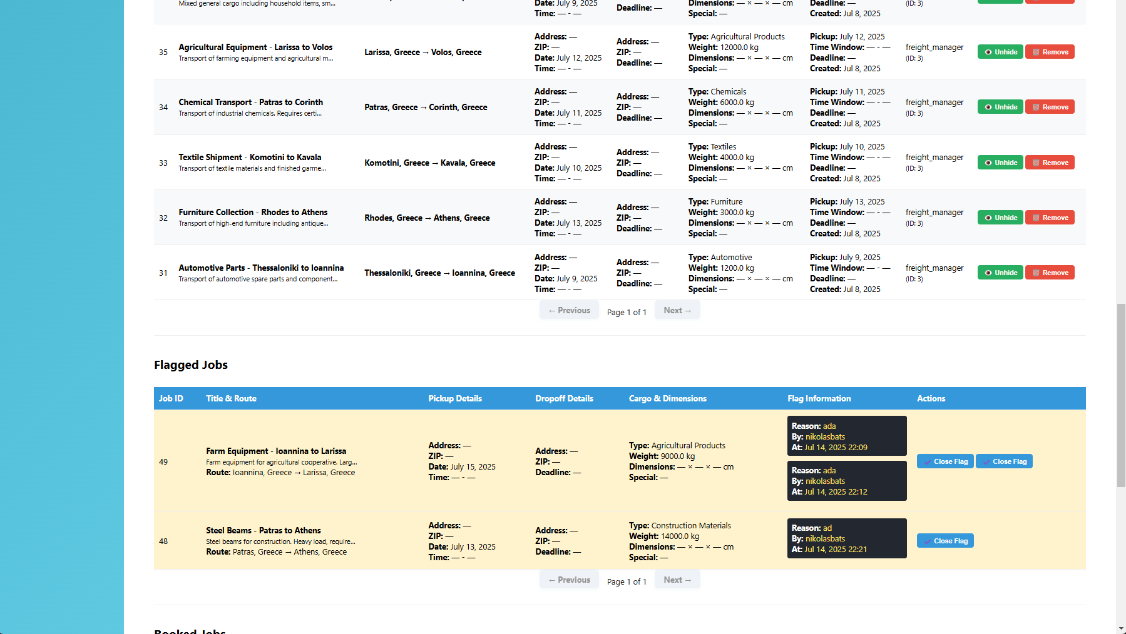

Slide 11
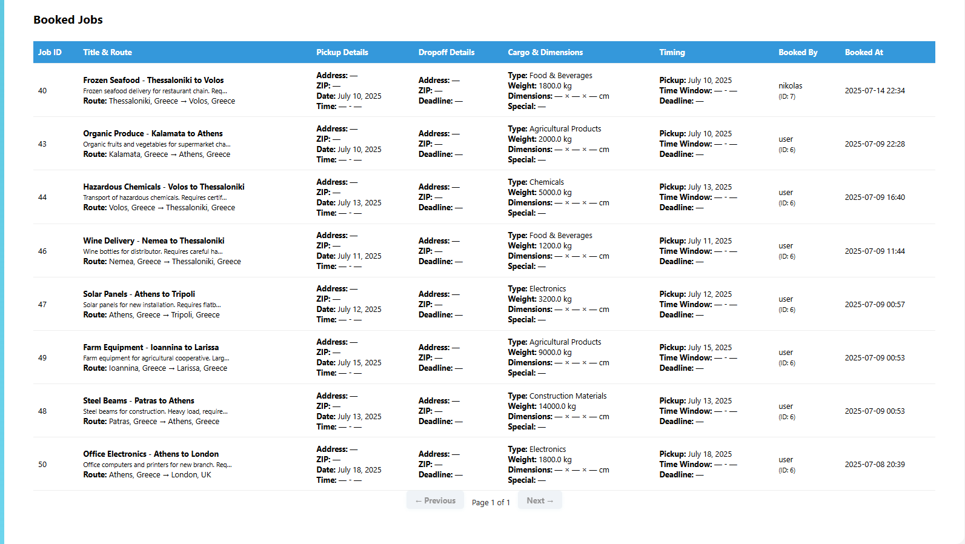

Slide 12
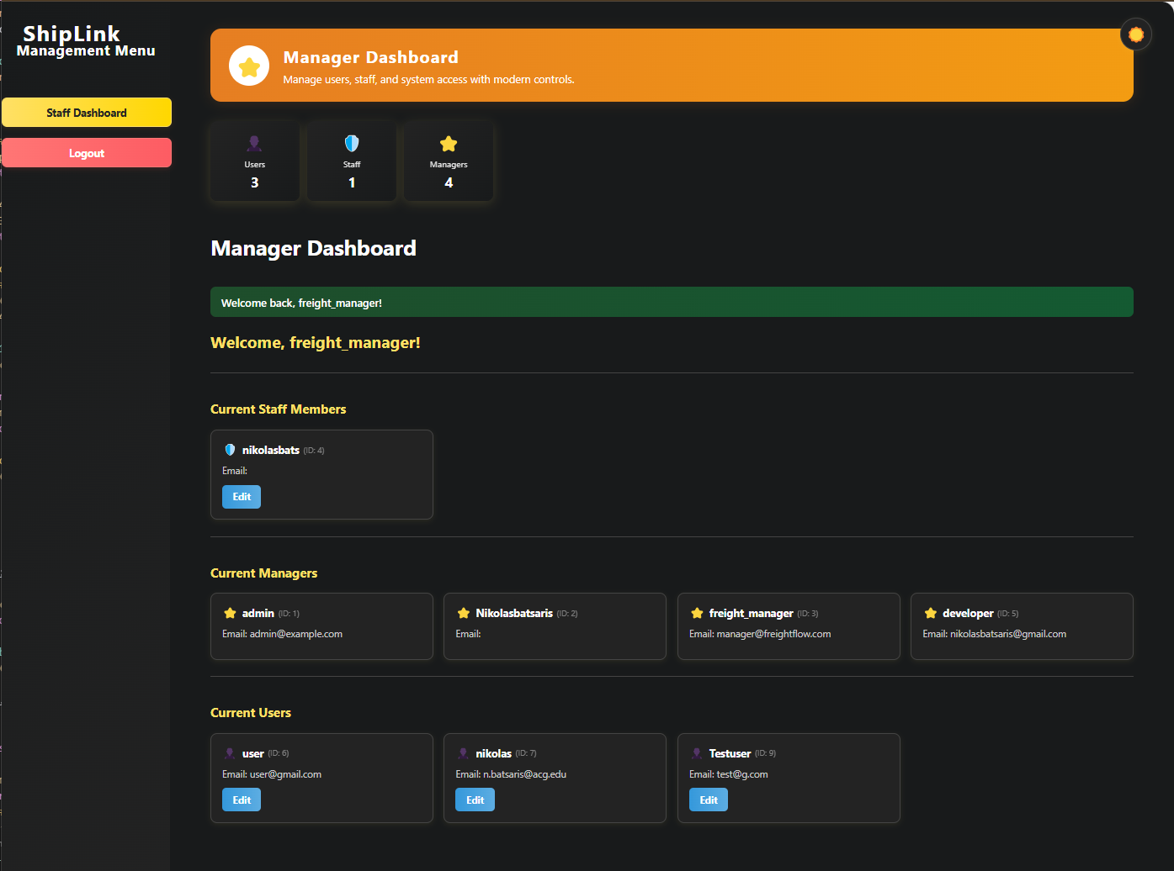
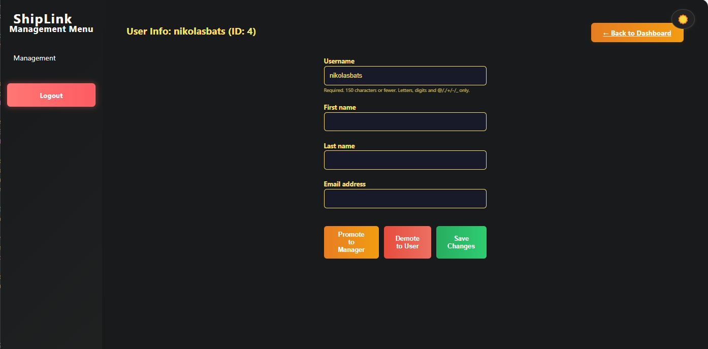
Management Menu
Edit user permissions & info

Slide 13
THANK YOU

